Slide 1
QA Consultancy DevOps February 2020
SFIA Project 1 – Workout Application
David Hulsman
The brief
My Solution
Testing
Front End
DevOps
Demonstration
Summary

Slide 2
The brief
" Your overall objective with this project is the following: - To create a CRUD application with utilisation of supporting tools, methodologies and technologies that encapsulate all core modules covered during training. "
The use of two relational tables
Complete utilization of CRUD functionality in application
Fully designed test suites
Integration into a version control system
The brief
My Solution
Testing
Front End
DevOps
Demonstration
Summary

Slide 3
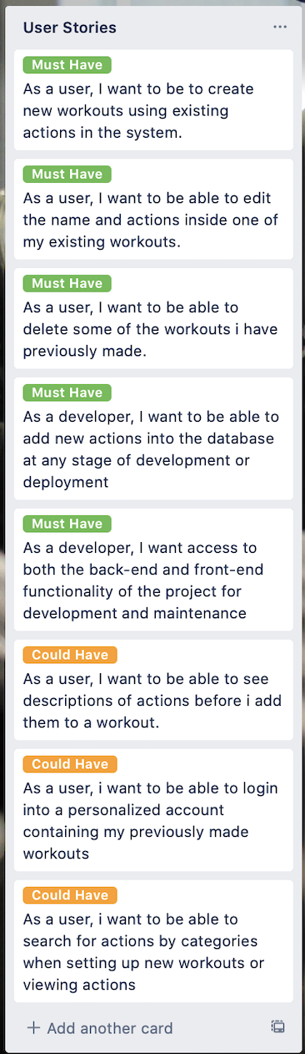
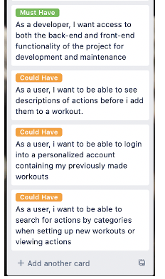
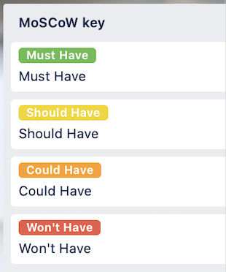
My solution
The brief
My Solution
Testing
Front End
Demonstration
DevOps
Summary

Slide 4
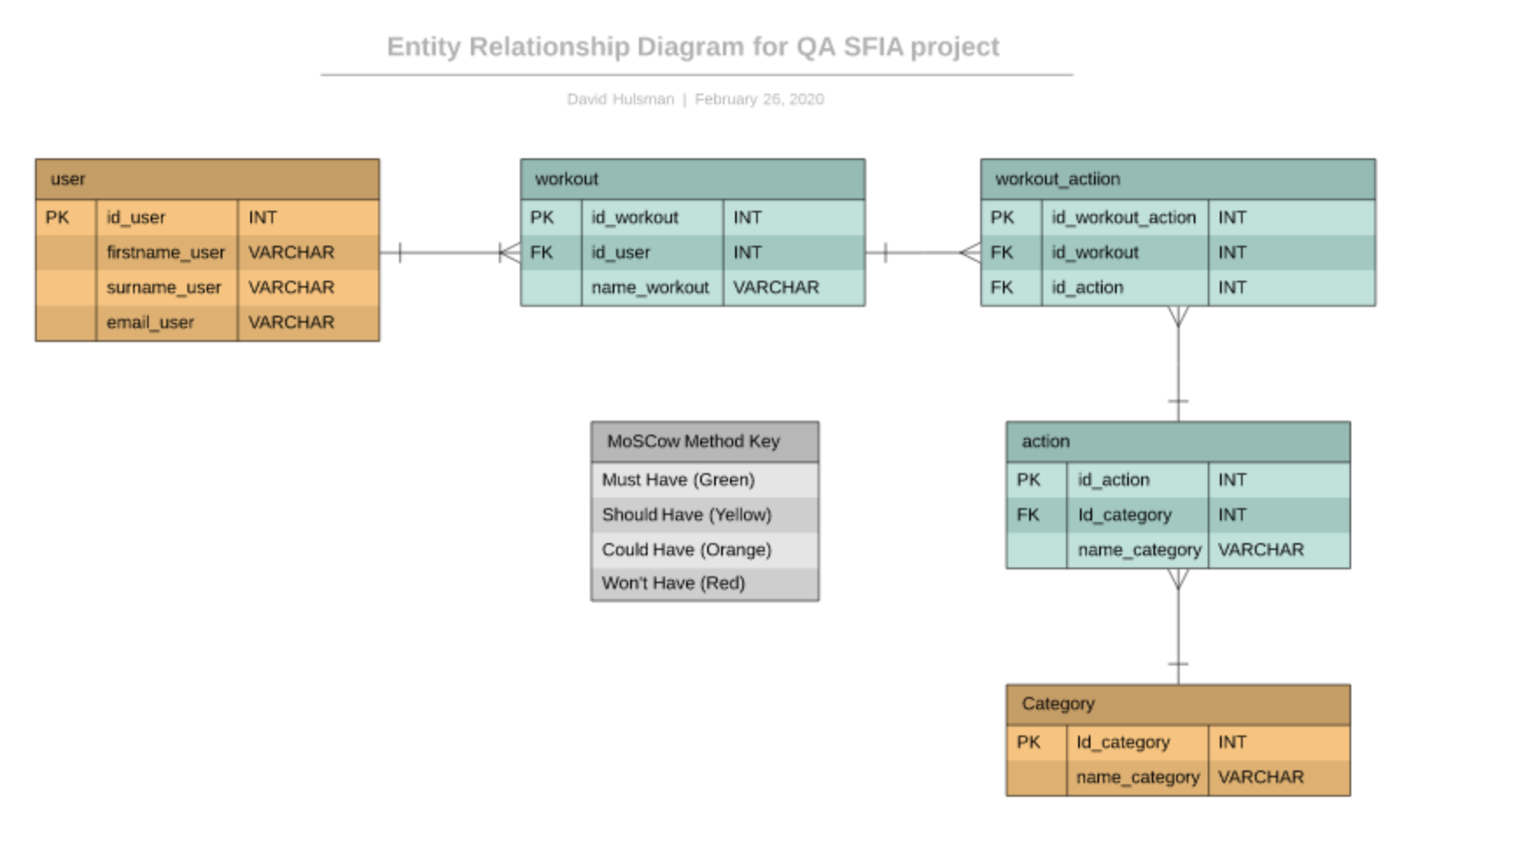
My solution
The brief
My Solution
Testing
Front End
Demonstration
DevOps
Summary

Slide 5
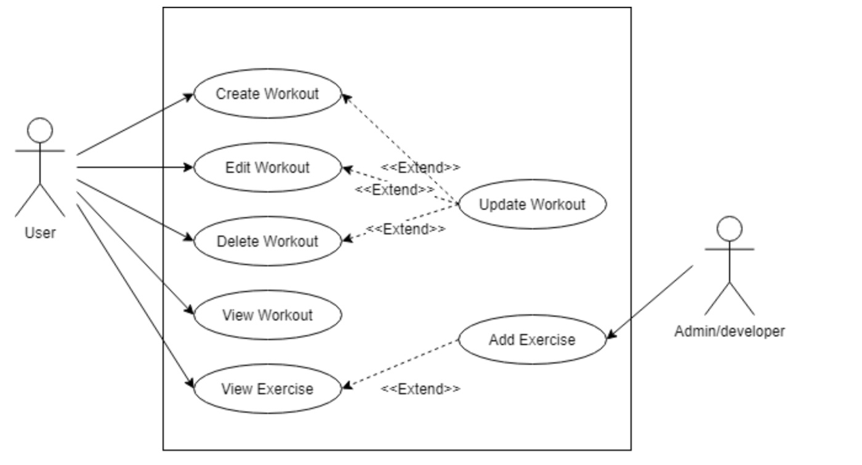
My solution
The brief
My Solution
Testing
Front End
Demonstration
DevOps
Summary

Slide 6
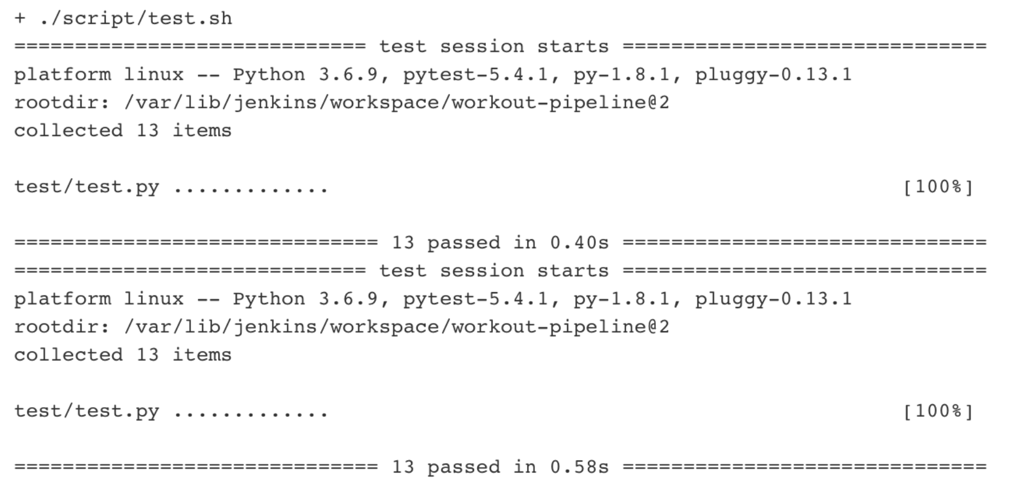
Testing: PyTest
The brief
My Solution
Testing
Front End
DevOps
Demonstration
Summary

Slide 7
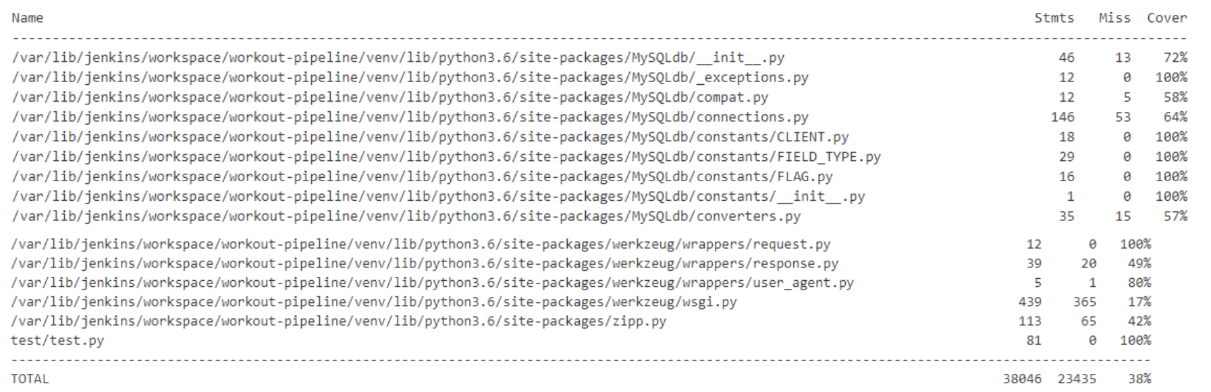
Testing: Jenkins coverage report
The brief
My Solution
Testing
Front End
DevOps
Demonstration
Summary

Slide 8
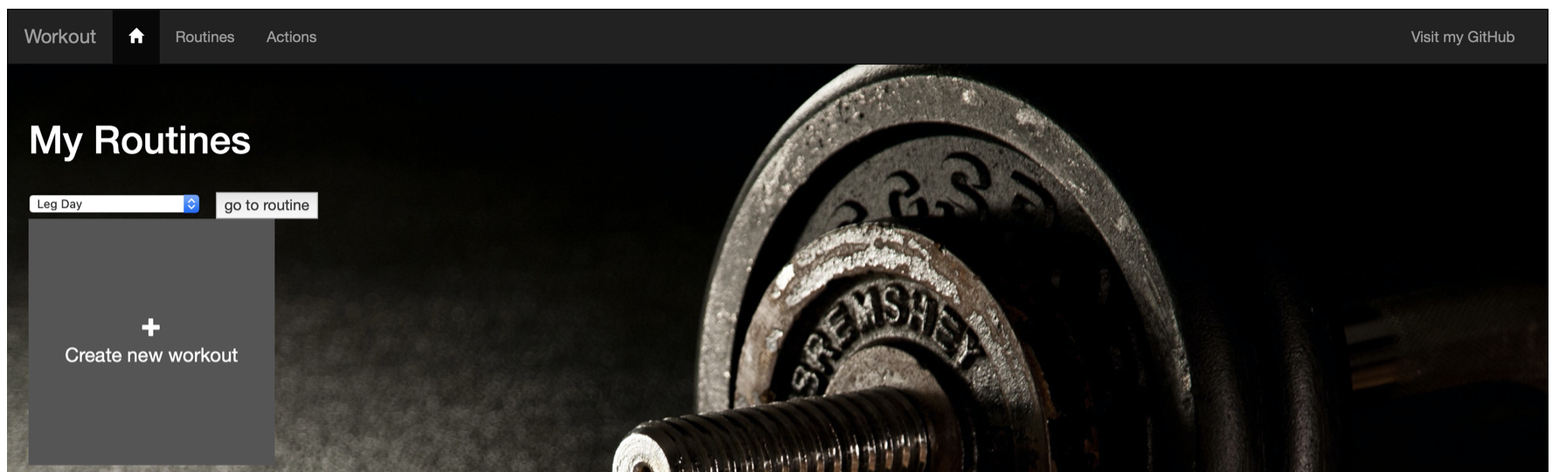
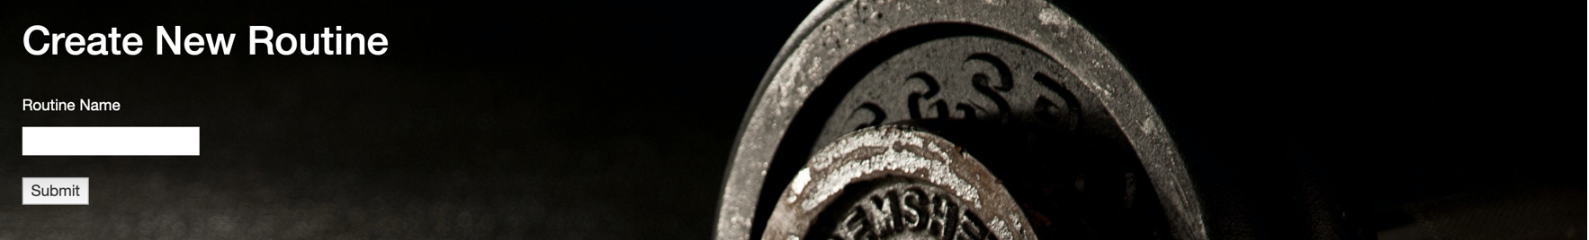
Front End: HTML, Bootstrap, Flask, Jinja2
The brief
My Solution
Testing
Front End
DevOps
Demonstration
Summary

Slide 9
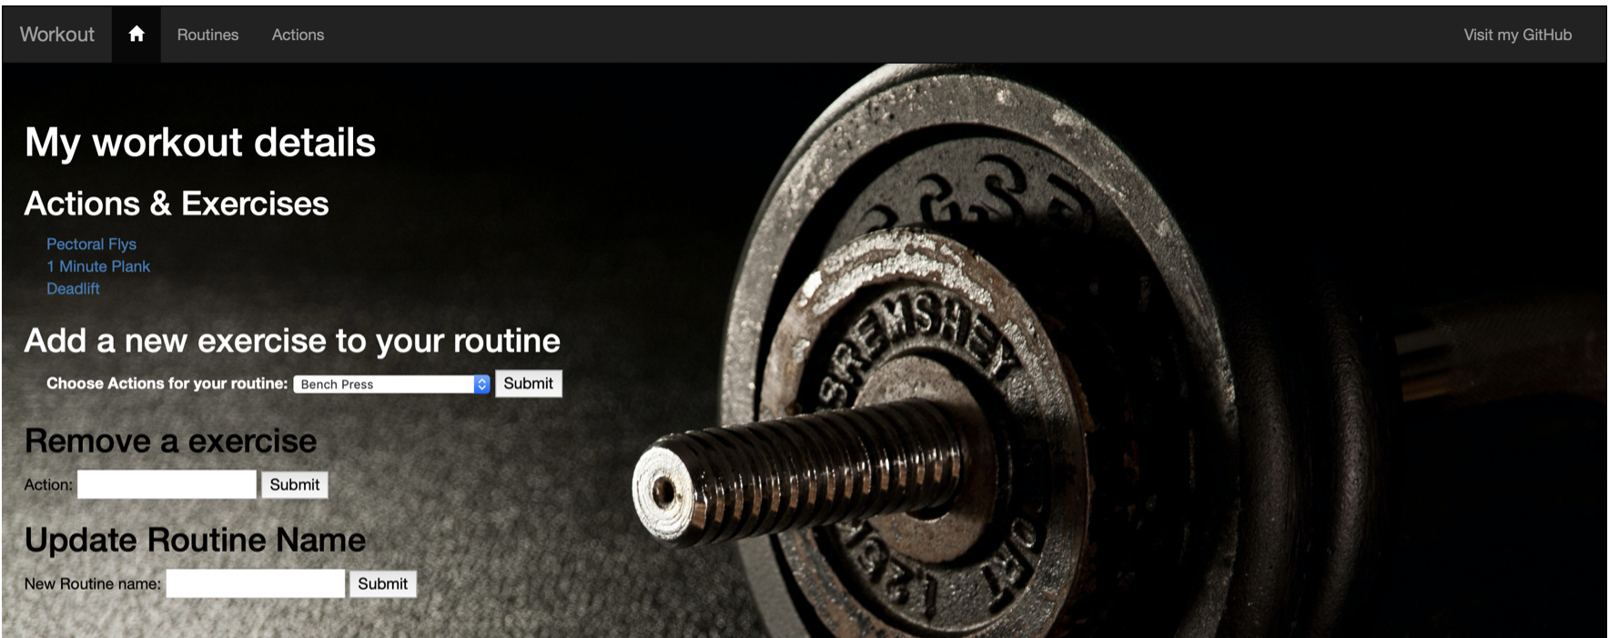
Front End: HTML, Bootstrap, Flask, Jinja2
The brief
My Solution
Testing
Front End
DevOps
Demonstration
Summary

Slide 10
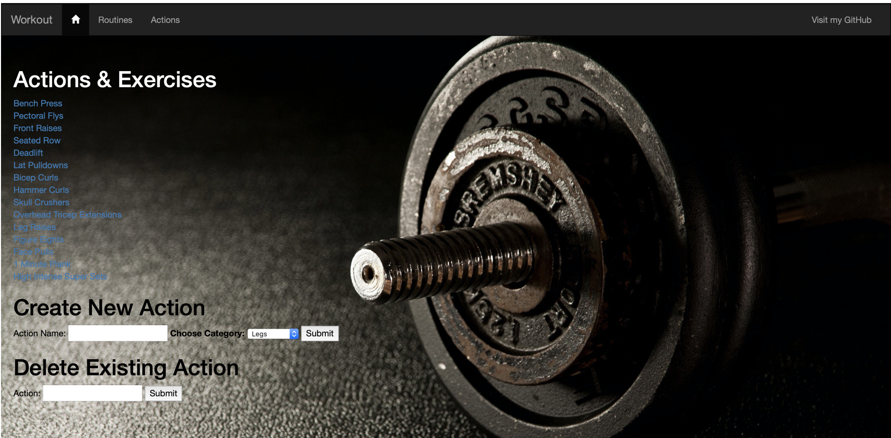
Front End: HTML, Bootstrap, Flask, Jinja2
The brief
My Solution
Testing
Front End
DevOps
Demonstration
Summary

Slide 11
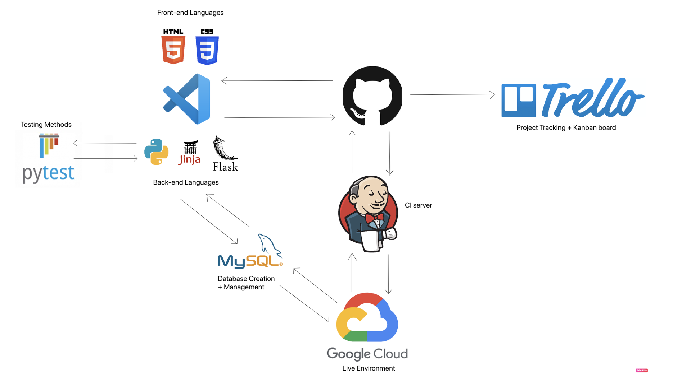
DevOps and Continuous Integration
The brief
My Solution
Testing
Front End
DevOps
Demonstration
Summary

Slide 12
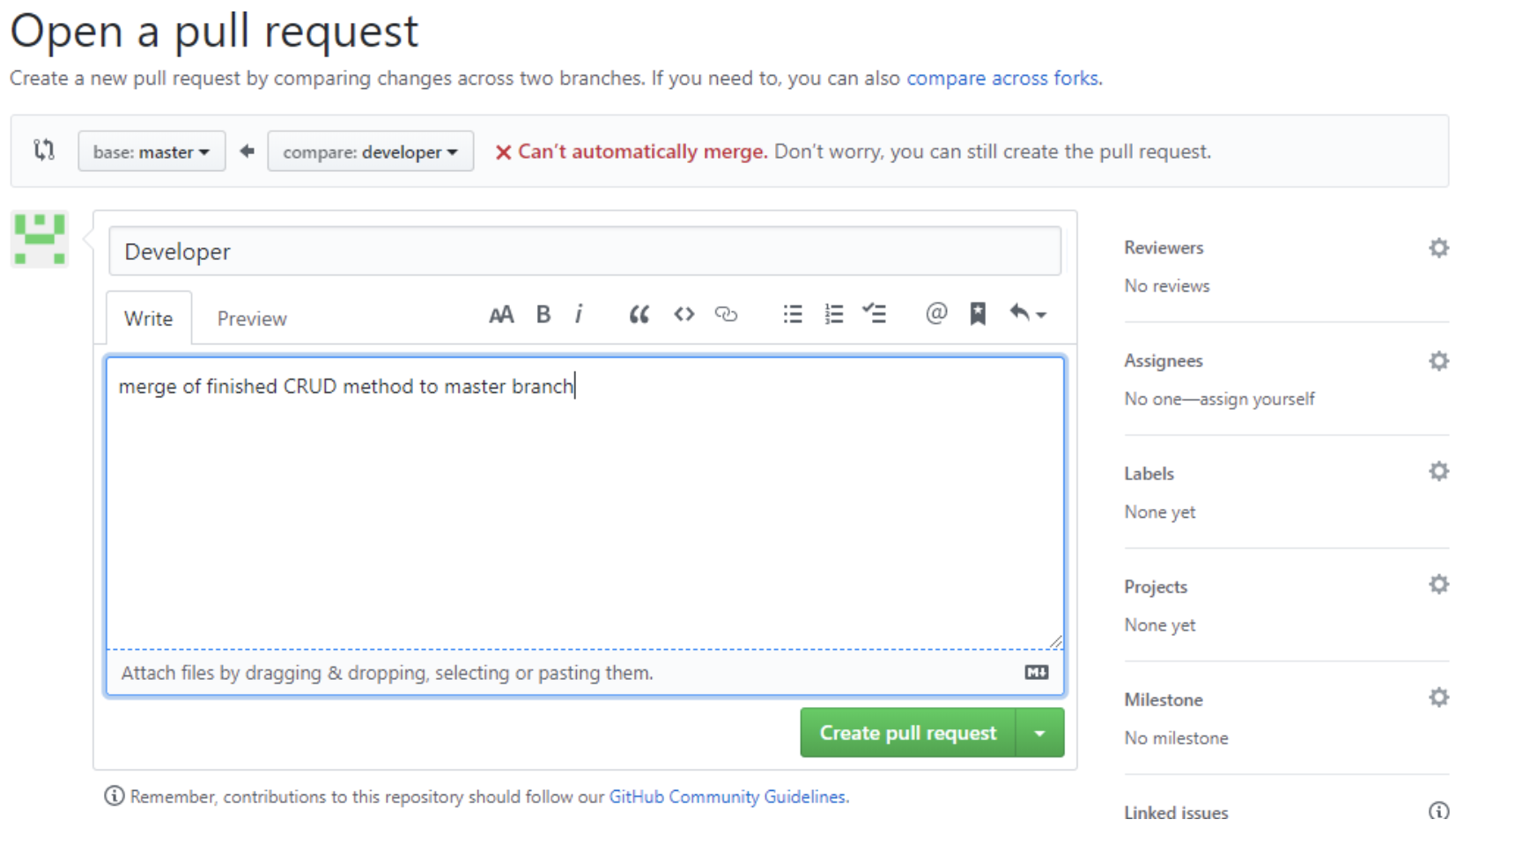
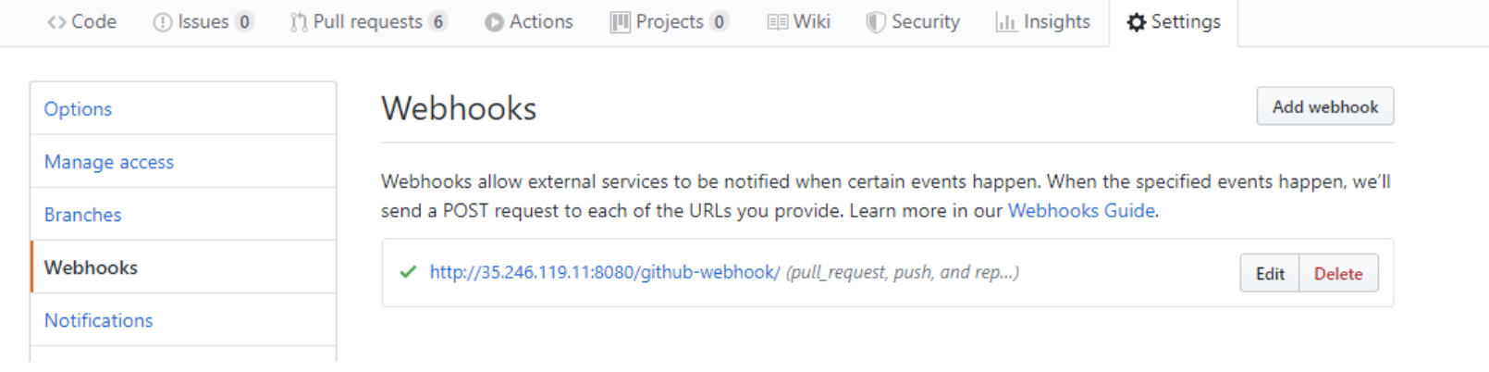
Project Retrospective
What went well
Use of Many-to-many relationships
Good use of DevOps Practices
Agile Methodology
GitHub > Jenkins webhook
Website aesthetics
CRUD Functionality
The brief
My Solution
Testing
Front End
DevOps
Demonstration
Summary

Slide 13
Project Retrospective
What could have gone better
Lack of use for Category Table
Absence of Login feature
Better Planning with regards to CRUD
The brief
My Solution
Testing
Front End
DevOps
Demonstration
Summary

Slide 14
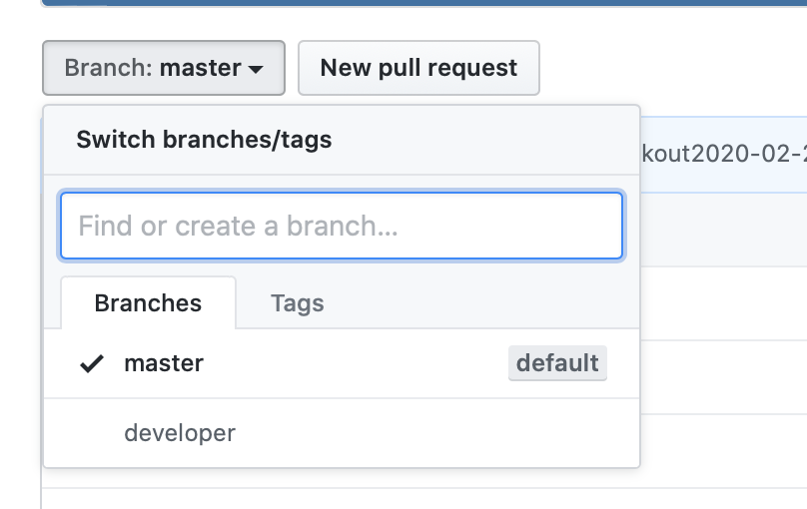
Project Retrospective
Improvements for the future
Increased test coverage
Dyanamic pages
Better Branch management
Better use of Git
The brief
My Solution
Testing
Front End
DevOps
Demonstration
Summary

Slide 15
Demonstration
˃ Showcase of finished project

Slide 16
Questions and Feedback
˃ Thank you for listening

Slide 17
References
The logos of the software's used are owned by their retrospective companies and owners
The PowerPoint template is was obtained from BAE systems.

